Slide 1
CSC 112: Computer Operating Systems Lecture XX Cache Deleted
Department of Computer Science,
Hofstra University

Slide 2
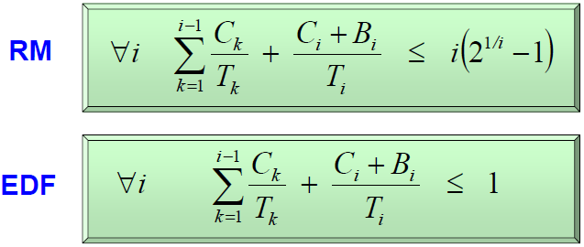
Utilization Bound w/ Blocking Time
Compute the maximum blocking time B_{i} for each task Tau_{i}
Inflate C_{i} by B_{i}
Notes:
For RM
Non Preemptive Protocol (NPP)
Highest Locker Priority (HLP)
Priority Inheritance (PIP)
Priority Ceiling (PCP)
Under EDF
Non Preemptive Protocol (NPP)
Dynamic Priority Inheritance (D-PIP)
Dynamic Priority Ceiling (D-PCP)
Stack Resource Policy (SRP)
We did not discuss D-PIP, D-PCP, SRP in class.

Slide 3
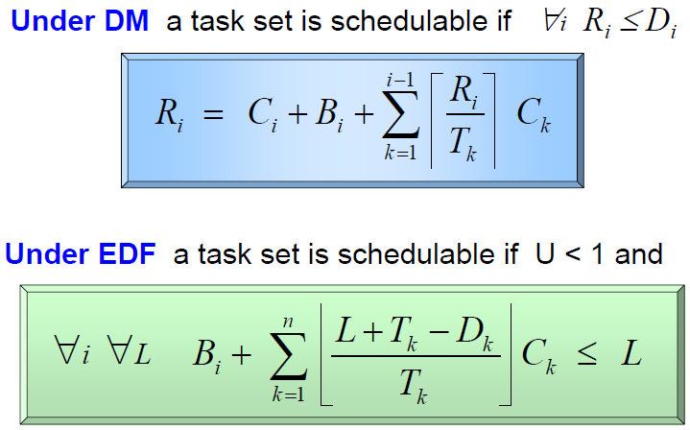
Exact Schedulability Analysis
RM or DM: Response Time Analysis (RTA)
EDF: Processor Demand Analysis

Slide 4
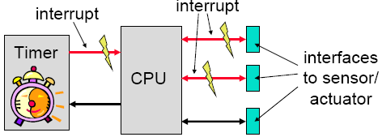
Event-Triggered (ET) Systems
Task release is triggered by external interrupts or events
Notes:
dynamic and adaptive: there are possible problems with respect to timing, the use of shared resources and buffer over-or underflow
guarantees can be given either off-line (if bounds on the behavior of the environment are known) or during run-time

Slide 5
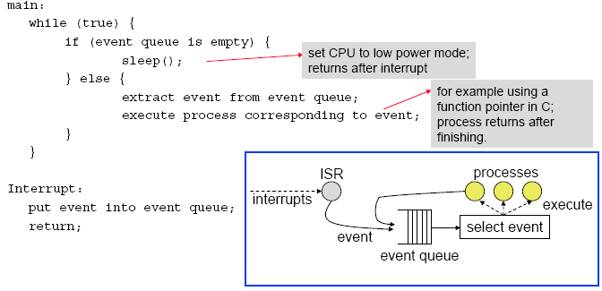
Non-Preemptive ET Scheduling Example
Notes:
Principle:
To each event, there is associated a corresponding process that will be executed.
Events are emitted by (a) external interrupts and (b) by processes themselves.
Events are collected in a queue; depending on the queuing discipline, an event is chosen for running.
Processes can not be interrupted.
Extensions:
A background process can run (and preempted!) if the event queue is empty.
Timed events enter the queue only after a time interval elapsed. This enables periodic instantiations for example.

Slide 6
Co-operative Multitasking
Each task allows a context switch at cswitch() call. OS scheduler chooses which task runs next.
Advantages:
predictable, where context switches can occur
less errors with use of shared resources
Problems:
real-time behavior at risk if it takes too long before context switch allowed

Slide 7
Example

Slide 8
Preemptive Multitasking

Slide 9
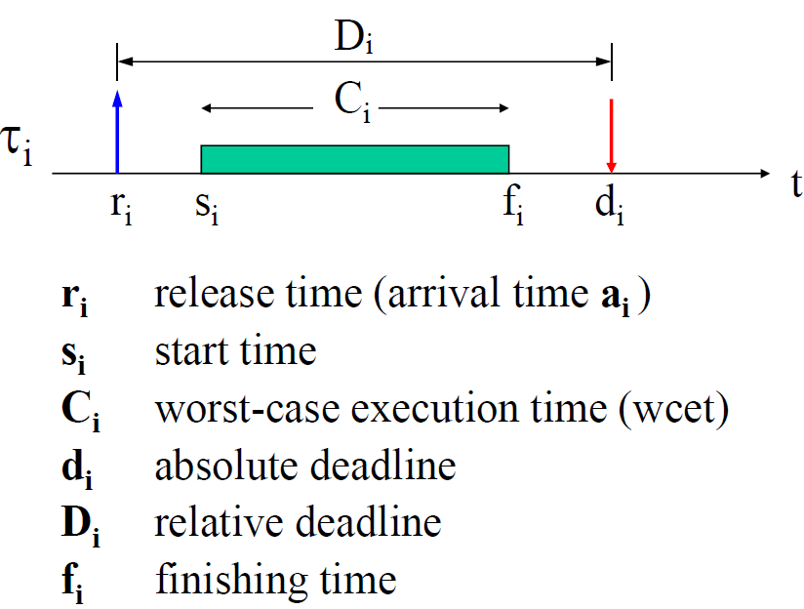
Periodic Task Params
Notes:
A schedule is said to be feasible, if all task can be completed according to a set of specified constraints.
A set of tasks is said to be schedulable, if there exists at least one algorithm that can produce a feasible schedule.
Arrival time or release time is the time at which a task becomes ready for execution.
Computation time is the time necessary to the processor for executing the task without interruption.
Deadline is the time at which a task should be completed.
Start time is the time at which a task starts its execution.
Finishing time is the time at which a task finishes its execution.

Slide 10
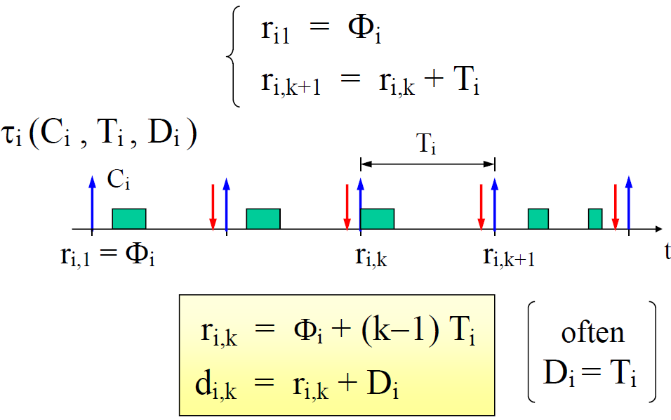
Periodic Task Model
Release Offset

Slide 11
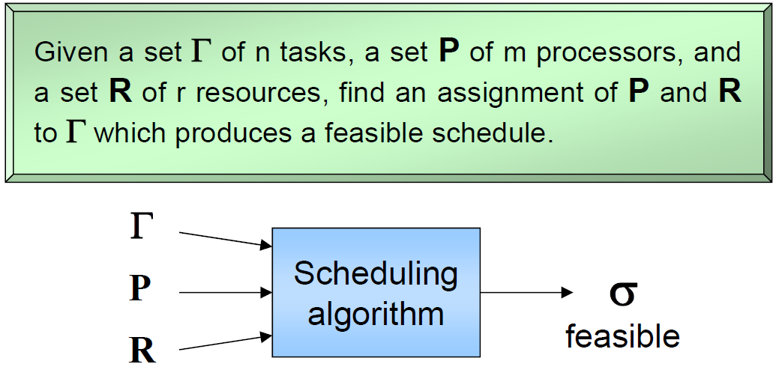
The General Scheduling Problem

Slide 12
Preemptive vs. Non-Preemptive
A scheduling algorithm is:
preemptive: if the active job can be temporarily suspended to execute a more important job.
non preemptive: if the active job cannot be suspended, i.e., always runs to completion.

Slide 13
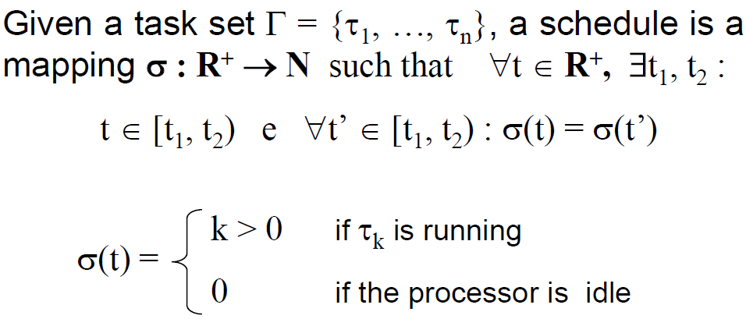
Schedule
When used as a noun, a schedule is an execution trace
When used as a verb, to schedule a taskset is to find a feasible schedule (noun)

Slide 14
Definitions
A schedule σ is feasible if all tasks meet their deadlines given a set of constraints
A taskset Γ is schedulable if there exists a feasible schedule for it

Slide 15
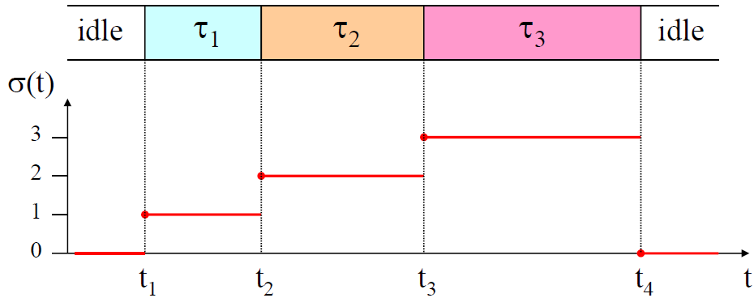
An Example Schedule
At time t₁, t₂, t₃, t₄, a context switch is performed

Slide 16
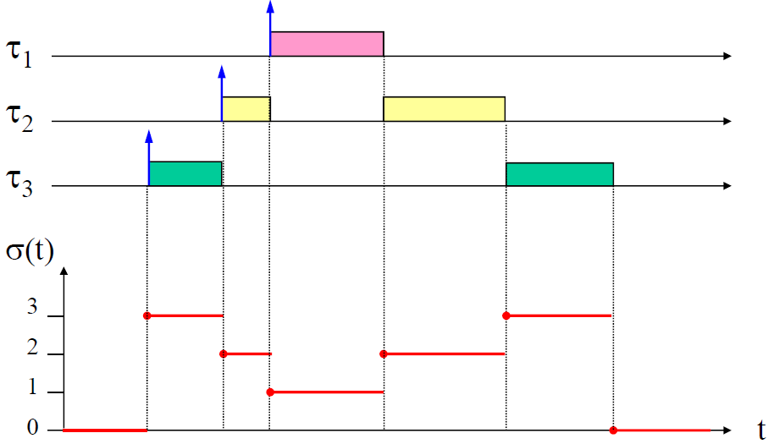
A Preemptive Schedule
Priority τ₁>τ₂>τ₃
Convention: higher-priority tasks are placed higher in the schedule chart

Slide 17
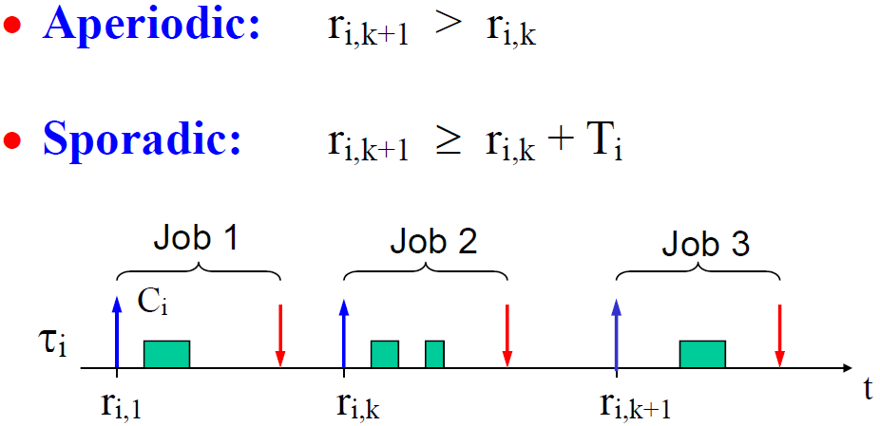
Aperiodic and Sporadic Task Model

Slide 18
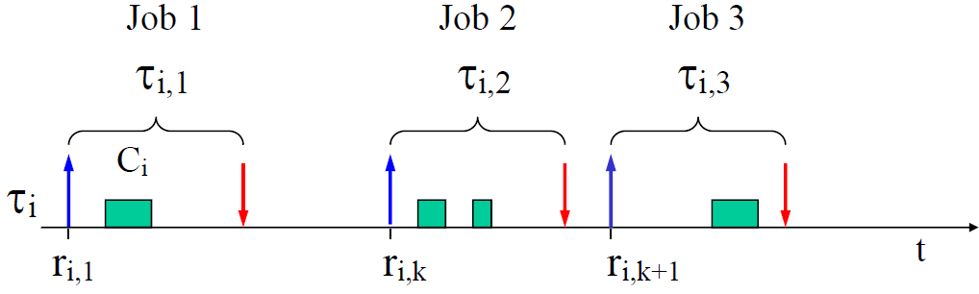
Definition: Task & Job
A task is an infinite sequence of jobs

Slide 19
Types of Tasks
Periodic task
Triggered at fixed periods by a timer
Aperiodic task
Triggered by external interrupts
Sporadic task
Triggered by external interrupts, but with minimum inter-arrival time (MIT) between interrupts
Can be treated as a periodic task with period equal to MIT
We typically assume periodic task model for schedulability analysis

Slide 20
Slack and Lateness
A task’s worst-case response time R_{i} =f_{i} - a_{i} is defined as the worst-case finish time minus its arrival time
It includes Worst-Case Execution Time (WCET) C_{i} plus possible delays caused by other concurrent tasks in the system
“Slack” if lateness is negative (task completes before deadline)
“Tardiness” or “exceeding time” E_{i} = max(0, L_{i})
D_{i}
τ_{i}
a_{i}
s_{i}
f_{i}
d_{i}
t
R_{i}
C_{i}
D_{i}
lateness
L_{i} = f_{i} - d_{i}
τ_{i}
t
ªi ^{s}i
d_{i} f_{i}
t
a_{i} s_{i} f_{i}
R_{i}
Notes:
“Laxity” or “slack time” X_{i} = d_{i} – a_{i} – C_{i} slack_{i} = d_{i} - f_{i}

Slide 21
How to prevent a user-level thread from hogging the CPU?
Strategy 1: force everyone to cooperate
a thread willingly gives up the CPU by calling yield()
yield() calls into the scheduler, which context switches to another ready thread
what happens if a thread never calls yield()?
Strategy 2: use preemption
scheduler requests that a timer interrupt be delivered by the OS periodically
usually delivered as a UNIX signal (man signal)
signals are just like software interrupts, but delivered to user-level by the OS instead of delivered to OS by hardware
at each timer interrupt, scheduler gains control and context switches as appropriate

Slide 22
Thread context switch
Very simple for user-level threads:
save context of currently running thread
push machine state onto thread stack
restore context of the next thread
pop machine state from next thread’s stack
return as the new thread
execution resumes at PC of next thread
This is all done by assembly language
it works at the level of the procedure calling convention
thus, it cannot be implemented using procedure calls
e.g., a thread might be preempted (and then resumed) in the middle of a procedure call

Slide 23
What if a thread tries to do I/O?

Slide 24
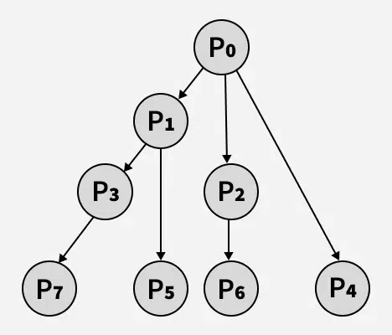
Fork Quiz
The number of times ‘hello’ is printed is equal to the total number of processes = 2^n, where n is the number of fork system calls. So here n = 3, 2^3 = 8.
Main process: P0
1 child process created by the 1st fork: P1
2 child processes created by the 2nd fork: P2, P3
4 child processes created by the 3rd fork: P4, P5, P6, P7
In general, for (i = 0; i < n; i++) fork();” creates 1+2+…+2^(n-1)=(2^n)-1 child processes. Plus the main process P0, we have a total of 2^n processes.
Order of process execution may vary depending on how OS schedules these processes, so you don’t know which process printed which hello.
None of the processes include a wait() call to handle terminated child processes. When any of these child processes terminate, their PCBs remain in the process table as no parent process is waiting on them, resulting in zombie processes. (This also applies to the following examples.)
Output:
hello
hello
hello
hello
hello
hello
hello
hello
Notes:
The number of times ‘hello’ is printed is equal to the number of processes created. Total Number of Processes = 2^{n}, where n is the number of fork system calls. So here n = 3, 2³ = 8 Let us put some label names for the three lines:’
Let us put some label names for the three lines:
fork (); // Line 1
fork (); // Line 2
fork (); // Line 3
L1 // 1 child process created by line 1.
/ \
L2 L2 // 2 child processes created by line 2.
/ \ / \
L3 L3 L3 L3 // 4 child processes created by line 3.

Slide 25
Typical Memory Hierarchy
On-Chip Components
Control
Instr
Cache
Second
Level
Cache
(SRAM)
Secondary
Memory
(Disk
Or Flash)
Main
Memory
(DRAM)
Datapath
RegFile
Data
Cache
Speed (cycles): ½’s 1’s 10’s 100’s 1,000,000’s
Size (bytes): 100’s 10K’s M’s G’s T’s
Cost/bit: highest lowest
25
Notes:
Instead, the memory system of a modern computer consists of a series of black boxes ranging from the fastest to the slowest.
Besides variation in speed, these boxes also varies in size (smallest to biggest) and cost.
What makes this kind of arrangement work is one of the most important principle in computer design. The principle of locality. The principle of locality states that programs access a relatively small portion of the address space at any instant of time.
The design goal is to present the user with as much memory as is available in the cheapest technology (points to the disk).
While by taking advantage of the principle of locality, we like to provide the user an average access speed that is very close to the speed that is offered by the fastest technology.
(We will go over this slide in detail in the next lectures on caches).

Slide 26
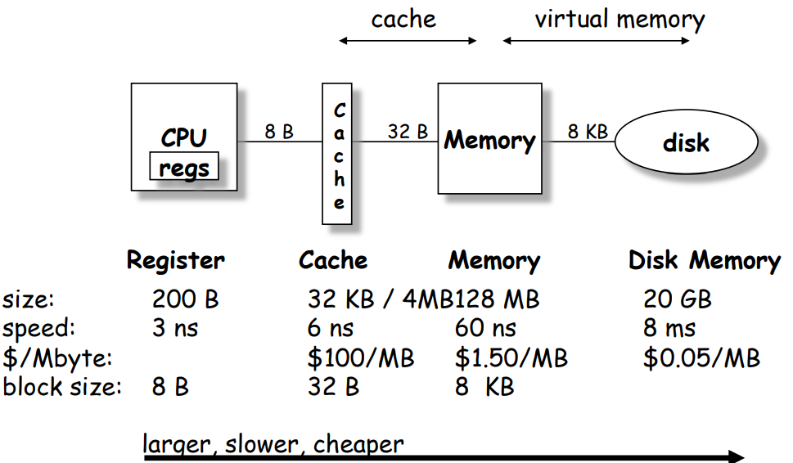
Memory Hierarchy

Slide 27
TLB Example This is wrong. A Page is 4KB and can contain 1K integers, not 4 integers.
In virtual memory space layout, array elements a[0] to a[2] are in the same memory page with VPN 06; a[3] to a[6] in the same memory page with VPN 07; a[7] to a[9] in the same memory page with VPN 08;
OFFSET 00 04 08 12 16
VPN = 00
VPN = 01
VPN = 03
VPN = 04
VPN = 05
VPN = 06 |  | a[0] | a[1] | a[2]
VPN = 07 | a[3] | a[4] | a[5] | a[6]
VPN = 08 | a[7] | a[8] | a[9]
VPN = 09
VPN = 10
VPN = 11
VPN = 12
VPN = 13
VPN = 14
VPN = 15
0: int sum = 0 ;
1: for( i=0; i<10; i++){
2: sum+=a[i];
3: }
3 misses for looking up physical memory addresses of a[0], a[3], and a[7]. 7 hits for looking up physical memory addresses of the other array elements a[0], a[3], and a[7]. Thus TLB hit rate is 70%.
TLB improves performance due to spatial locality of page table lookups.
Notes:
Another example to show

Slide 28
Table Lookaside Buffer (TLB)
Temporal Locality
An instruction or data item that has been recently accessed will likely be re-accessed soon in the future.
Spatial Locality
If a program accesses memory at address x, it will likely soon access memory near x.
1st access is page1.
2nd access is also page1.
Page 6
…
Page 1
Page 7
Page 2
Page 3
Page 4
Page 5
Page n
Virtual Memory
1st access is page1.
2nd access is nearby page1.
Page 1
Page 2
Page 3
Page 4
Page 5
…
Page n
Virtual Memory

Slide 29
Quiz IV
Consider 8-bit address space; a DM, write-back, write-allocate cache that can hold two blocks of 8 Bytes each. The cache is initially empty. The following sequence of memory operations are made, where each reference is a byte address of a 4-byte number (Only consider word aligned word addresses, i.e. locations 0, 4, 8, and so on. lw: load word; sw: store word) :
lw 0
sw 44
lw 52
lw 88
lw 0
sw 52
lw 68
lw 44
Work out the cache behavior after each operation.
Notes:
Tag: 4 Index: 1 Offset: 3. The low-order 3 bits of an address specifies the byte address, and the next 1 bit is the index. I'll write addresses as a triple of tag:index:offset. We have:
lw 0 = 0000:0:000
Bytes 0-7 loaded into cache index 0.
sw 44= 0010:1:100
Bytes 40-47 loaded into cache index 1; bytes 44-47 modified; block marked "dirty".
lw 52 = 0011:0:100
Bytes 48-55 loaded into cache index 0; Clean miss (since replaced block was clean), previous block discarded
lw 88 = 0101:1:000
Bytes 88-95 loaded into cache index 1; Dirty miss (since replaced block was dirty); previous (dirty) contents written back to memory; block marked "clean“
lw 0 = 0000:0:000
Bytes 0-7 loaded into cache index 0. Clean miss; block marked “clean”
sw 52 = 0011:0:100
Bytes 48-55 loaded into cache index 0. Clean miss. bytes 52-55 modified; block marked "dirty".
lw 68 = 0010:0:100
Bytes 64-71 brought into cache index 0; Dirty miss; previous (dirty) contents written back to memory; block marked “clean”.
lw 44 = 0010:1:100
Bytes 40-47 loaded into cache index1; Clean miss; block marked "clean".

Slide 30
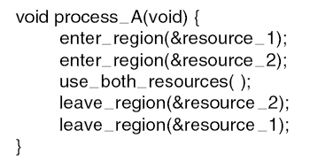
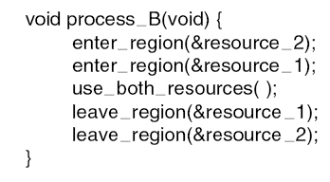
Livelock
Both processes use the polling primitive enter_region() to try to acquire locks via busy-waiting; process_A gets resource_1 and process_B gets resource_2.
Livelock, not deadlock, since no process is blocked.

Slide 31
Multi-Armed Lawyers
Consider a large table with IDENTICAL multi-armed alien lawyers. In the center is a pile of chopsticks. In order to eat, a lawyer must have one chopstick in each hand. The lawyers are so busy talking that they can only grab one chopstick at a time. Design a deadlock-free algorithm using monitors and Bankers algorithm. Assume total number of chopsticks >= number of hands of each lawyer, so at least one lawyer can eat.

Slide 32
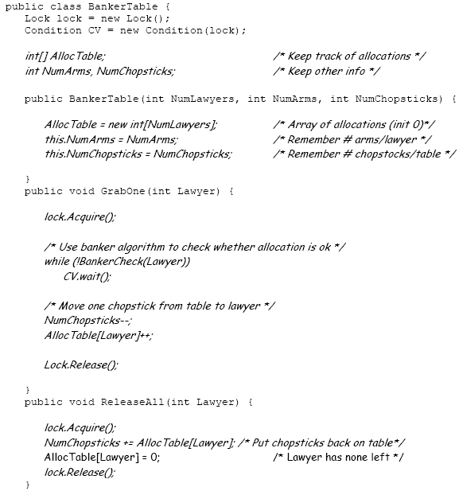
GrabOne() allows a lawyer to grab one chopstick. It puts a lawyer to sleep if he cannot be granted a chopstick without potentially deadlocking the system.
ReleaseAll() allows a lawyer to release all chopsticks that he is holding. It wakes up any other lawyers that can proceed.
BankerCheck() method takes a Lawyer number, checks resources, and returns true if a given lawyer can be granted one new chopstick
Assume Mesa-style monitor, hence while loop is used in GrabOne().

Slide 33
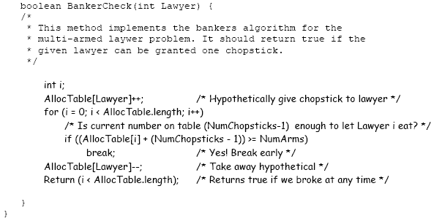
BankerCheck() Method
State is safe if when a lawyer tries to take a chopstick, either
It is the last chopstick, but someone will have NumArms chopsticks afterwards
Or it is the 2nd to last chopstick, but someone will have NumArms-1 chopsticks afterwards
Or it is the 3rd to last chopstick, but someone will have NumArms-2 chopsticks afterwards …
Or…

Slide 34
Dining Lawyers Questions I
Q: Why didn’t we check for the case of NumChopsticks == 0?
A: In this case, (NumChopsticks-1) == -1, hence the if statement would always fail – exactly what we would want to do when NumChopsticks == 0

Slide 35
Dining Lawyers Questions II
Q: Is it a generalization of the 2-armed Dining Philosophers problem?
A: Not exactly. Since the chopsticks are in a pile at center of the table, we should model them as a single resource with multiple instances, instead of multiple resources for the Dining Philosophers. Hence the R and C matrices have a single column.

Slide 36
Dining Lawyers Questions III
Q: In its general form, the Banker’s algorithm makes multiple passes through the set of resource takers, finishing one at a time until all resource takers have finished. Explain why this particular application allows the BankerCheck method to implement the Banker’s algorithm by taking a single pass (until any one lawyer can get NumArms chopsticks).
A: Since every Lawyer has the same maximum allocation, and all chopsticks are equivalent. As a result, if we can find a single Lawyer that can finish, given the remaining resources, we know that all Lawyers can finish.
Reason: once that Lawyer finishes and returns their resources we know that there will be at least NumArms chopsticks on the table – hence everyone else can potentially finish. Thus, we don’t have to go through the exercise of returning resources and reexamining the remaining Lawyers (as in the general specification of the Banker’s algorithm).

Slide 37
Dining Lawyers Variation I
Q: If each lawyer has 2 arms, and there is a pile of knives and forks at center of the table. Assume there are at least 1 knife and 1 fork, so at least one lawyer can eat. (There is no other constraint on the numbers of knives, forks, or lawyers.) Each lawyer follows the following steps:
(1) Pick up a knife
(2) Pick up a fork
(3) Eat
(4) Return the knife and fork to the pile
Can the system be deadlocked?
A: No, since it’s not possible to have circular waiting.

Slide 38
Dining Lawyers Variation II
Q: If each lawyer has 4 arms, and there is a pile of knives and forks at center of the table. Assume there are at least 2 knives and 2 forks, so at least one lawyer can eat. Each lawyer follows the following steps:
(1) Pick up 2 knives atomically
(2) Pick up 2 forks atomically
(3) Eat
(4) Return the knives and forks to the pile
Can the system be deadlocked?
A: No, since it’s not possible to have circular waiting.

Slide 39
Dining Lawyers Variation III
Q: If each lawyer has 4 arms, and there is a pile of knives and forks at center of the table. Assume there are at least 2 knives and 2 forks, so at least one lawyer can eat. Each lawyer follows the following steps:
(1) Pick up a knife
(2) Pick up another knife
(3) Pick up a fork
(4) Pick up another fork
(5) Eat
(6) Return the knife and fork to the pile
Can the system be deadlocked?
A: Yes, since requests for each resource type (knife or fork) are not granted atomically. Need Banker’s algorithm to detect (potential) deadlocks.
Consider 2 lawyers, and a total of 2 knives and 2 forks available. If each lawyer picks up a knife, the system is deadlocked.
Recall Slide 14 “Define a total order of resource types; If a process holds certain resources, it can subsequently request only resources that follow the types of held resources in the total order.” This means you cannot request a knife while holding a knife.

Slide 40
Dining Lawyers Variation III
Q: What if each lawyer sitting around the table may have a different number of arms, and may request a different ratio of knives vs. forks?
A: The solution is basically the same, except implementation of Banker’s algorithm needs to take into account this factor, e.g., have an array of variables NumArms[] instead of a single variable NumArms, and so on.

Slide 41
Measuring Cache Performance – Effect on CPI
Assuming cache hit costs are included as part of the normal CPU execution cycle, then
CPU time = IC (Instruction Count) × CPI (Cycles per Instruction)× CC (Clock Cycle)
= IC × (CPI_{ideal} + Average Memory-stall cycles) × CC
CPI_{stall}
A simple model for Memory-stall cycles
Memory-stall cycles = accesses/instruction × miss rate × miss penalty
Notes:
Reasonable write buffer depth (e.g., four or more words) and a memory capable of accepting writes at a rate that significantly exceeds the average write frequency means write buffer stalls are small

Slide 42
Impacts of Cache Performance
Relative $ penalty increases as processor performance improves (faster clock rate and/or lower CPI)
Memory speed unlikely to improve as fast as processor cycle time. When calculating CPI_{stall}, cache miss penalty is measured in processor clock cycles needed to handle a miss
Lower the CPI_{ideal}, more pronounced impact of stalls
Processor with a CPI_{ideal} of 2, a 100 cycle miss penalty, 36% load/store instr’s, and 2% I$ and 4% D$ miss rates
Memory-stall cycles = 2% × 100 + 36% × 4% × 100 = 3.44
So CPI_{stalls} = 2 + 3.44 = 5.44
More than twice CPI_{ideal}!
Notes:
What if the CPI_{ideal} is reduced to 1?
What if the D$ miss rate went up by 1%?
For ideal CPI = 1, then CPIstall = 4.44 and the amount of execution time spent on memory stalls would have risen from 3.44/5.44 = 63% to 3.44/4.44 = 77%
For miss penalty of 200, memory stall cycles = 2% 200 + 36% x 4% x 200 = 6.88 so that CPIstall = 8.88
This assumes that hit time (so hit time is 1 cycle) is not a factor in determining cache performance. A larger cache would have a longer access time (if a lower miss rate), meaning either a slower clock cycle or more stages in the pipeline for memory access.

